Slide 1
Digital Portfolio
STUDENT NAME: INDUJHA A
REGISTER NO AND NMID: 2428B0314/E449E2BFA8D5D849A8445DF685BFFD7F
DEPARTMENT: B.Sc COMPUTER SCIENCE WITH DATA ANALYTICS
COLLEGE: KPR COLLEGE OF ARTS SCIENCE AND RESEARCH
UNIVERSITY: BARATHIYAR UNIVERSITY

Slide 2
PROJECT TITLE
RESEARCH INTERESTS AND
PAPERS

Slide 3


AGENDA
Problem Statement
Project Overview
End Users
Tools and Technologies
Portfolio design and Layout
Features and Functionality
Results and Screenshots
Conclusion
Github Link
3/21/2024 Annual Review

Slide 4

PROBLEM STATEMENT
In today’s digital era, having a professional online presence is crucial for students and professionals. However, many individuals face challenges in showcasing their skills, achievements, and projects effectively. Traditional resumes fail to highlight creativity and real-time projects. Hence, there is a need for a personal portfolio website that reflects both technical and creative skills.

Slide 5

PROJECT OVERVIEW
This project focuses on developing a Portfolio Website that displays an individual’s academic background, skills, projects, certifications, and achievements in an attractive and structured way. The portfolio is responsive, user-friendly, and easily accessible from any device. It helps individuals present themselves professionally to recruiters, collaborators, and peers.

Slide 6

WHO ARE THE END USERS?
Students – To showcase academic projects, internships, and skills.
Job Seekers – To share resumes, experience, and technical expertise.
Freelancers – To present services and attract clients.
Researchers/Academicians – To highlight publications, research works, and academic achievements.
Employers/Recruiters – To quickly evaluate the profile of candidates.

Slide 7

TOOLS AND TECHNIQUES
Frontend: HTML, CSS, JavaScript
Frameworks/Libraries: Bootstrap, React.js (optional)
Backend (if included): Node.js, PHP, or Django
Database: MySQL / MongoDB (optional for dynamic data)
Version Control: Git, GitHub
Design Tools: Canva, Figma, Adobe XD

Slide 8
POTFOLIO DESIGN AND LAYOUT
Homepage: Introduction with name, tagline, and profile picture.
About Section: Personal details, education, and career goals.
Skills Section: Technical and soft skills displayed with progress bars or charts.
Projects Section: Highlight major projects with description, tech stack, and GitHub links.
Achievements/Certifications Section: Showcase awards, certifications, and recognitions.
Contact Section: Email, LinkedIn, GitHub, and contact form.
Responsive Design: Works on mobile, tablet, and desktop.
‹#›

Slide 9
FEATURES AND FUNCTIONALITY
Interactive and responsive UI/UX design.
Easy navigation across sections.
Integrated contact form.
Links to GitHub repositories and LinkedIn profiles.
Downloadable resume option.
SEO-friendly structure for visibility.
Dark/Light mode (optional advanced feature).

Slide 10
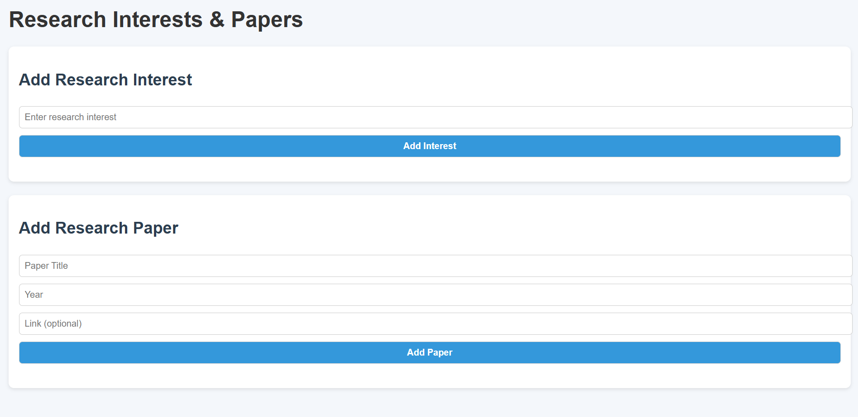

RESULTS AND SCREENSHOTS
Screenshots of the homepage, skills, projects, and contact section.
Demonstration of responsiveness across different devices.
Examples of integrated GitHub project links.
User-friendly interface with smooth animations.
3/21/2024 Annual Review
‹#›

Slide 11
CONCLUSION
The portfolio project provides a digital identity for individuals, enhancing their professional visibility and opportunities. It serves as a platform to showcase achievements, projects, and skills effectively. The portfolio not only improves job prospects but also helps in personal branding.
‹#›

Slide 12
GITHUB LINK
https://indujhaindujha8-star.github.io/Indujha8/

